Slide 1
Android Training
Supporting Different Devices
http://developer.android.com/training/index.html
师文轩，13920561100，shiwenxuan2003@hotmail.com

Slide 2
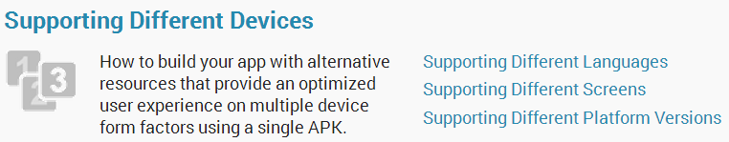
Supporting Different Devices

Slide 3
Intro
In order to be as successful as possible on Android, your app needs to adapt to various device configurations.
Some of the important variations that you should consider include different languages, screen sizes, and versions of the Android platform.

Slide 4
Lessons
Supporting Different Languages
Supporting Different Screens
Supporting Different Platform Versions

Slide 5
Supporting Different Languages
It’s always a good practice to extract UI strings from your app code and keep them in an external file.
Android makes this easy with a resources directory in each Android project.

Slide 6
If you created your project using the Android SDK Tools, the tools create a res/ directory in the top level of the project.
Within this res/ directory are subdirectories for various resource types.

Slide 7
Create Locale Directories and String Files
To add support for more languages, create additional values directories inside res/ that include a hyphen and the ISO country code at the end of the directory name.
At runtime, the Android system uses the appropriate set of string resources based on the locale currently set for the user's device.

Slide 8
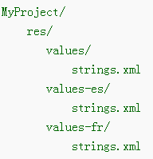
Once you’ve decided on the languages you will support, create the resource subdirectories and string resource files. For example:

Slide 9
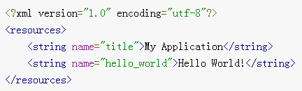
For example, the following are some different string resource files for different languages.
English (default locale), /values/strings.xml:

Slide 10
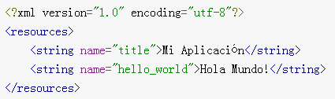
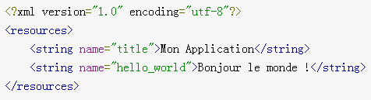
Spanish, /values-es/strings.xml:
French, /values-fr/strings.xml:

Slide 11
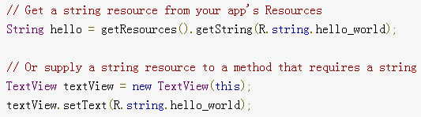
Use the String Resources
In your source code, you can refer to a string resource with the syntax R.string.<string_name>. There are a variety of methods that accept a string resource this way.
For example:

Slide 12
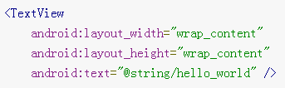
In other XML files, you can refer to a string resource with the syntax @string/<string_name> whenever the XML attribute accepts a string value.
For example:

Slide 13
Supporting Different Screens
Android categorizes device screens using two general properties: size and density.
There are four generalized sizes: small, normal, large, xlarge
And four generalized densities: low (ldpi), medium (mdpi), high (hdpi), extra high (xhdpi)

Slide 14
To declare different layouts and bitmaps you'd like to use for different screens, you must place these alternative resources in separate directories, similar to how you do for different language strings.
Also be aware that the screens orientation (landscape or portrait) is considered a variation of screen size.

Slide 15
Create Different Layouts
To optimize your user experience on different screen sizes, you should create a unique layout XML file for each screen size you want to support.

Slide 16
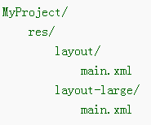
For example, this project includes a default layout and an alternative layout for large screens:
The file names must be exactly the same, but their contents are different in order to provide an optimized UI for the corresponding screen size.

Slide 17
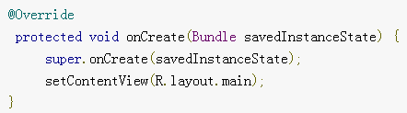
Simply reference the layout file in your app as usual:
The system loads the layout file from the appropriate layout directory based on screen size of the device on which your app is running.

Slide 18
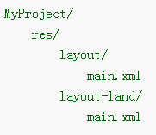
As another example, here's a project with an alternative layout for landscape orientation:
By default, the layout/main.xml file is used for portrait orientation.

Slide 19
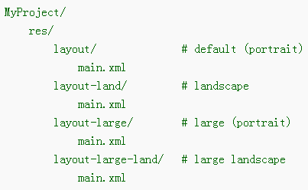
If you want to provide a special layout for landscape, including while on large screens, then you need to use both the large and land qualifier:

Slide 20
Create Different Bitmaps
You should always provide bitmap resources that are properly scaled to each of the generalized density buckets: low, medium, high and extra-high density.

Slide 21
To generate these images, you should start with your raw resource in vector format and generate the images for each density using the following size scale:
xhdpi: 2.0
hdpi: 1.5
mdpi: 1.0 (baseline)
ldpi: 0.75
This means that if you generate a 200x200 image for xhdpi devices, you should generate the same resource in 150x150 for hdpi, 100x100 for mdpi, and 75x75 for ldpi devices.

Slide 22
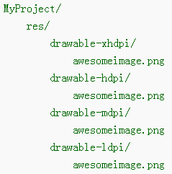
Then, place the files in the appropriate drawable resource directory:

Slide 23
Any time you reference @drawable/awesomeimage, the system selects the appropriate bitmap based on the screen's density.
Note: Low-density (ldpi) resources aren’t always necessary. When you provide hdpi assets, the system scales them down by one half to properly fit ldpi screens.

Slide 24
Supporting Different Platform Versions
While the latest versions of Android often provide great APIs for your app, you should continue to support older versions of Android until more devices get updated.
Tip: In order to provide the best features and functionality across several Android versions, you should use the Android Support Library in your app, which allows you to use several recent platform APIs on older versions.

Slide 25
Specify Minimum and Target API Levels
The AndroidManifest.xml file describes details about your app and identifies which versions of Android it supports.
Specifically, the minSdkVersion and targetSdkVersion attributes for the <uses-sdk element identify the lowest API level with which your app is compatible and the highest API level against which you’ve designed and tested your app.

Slide 26
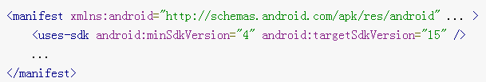
For example:

Slide 27
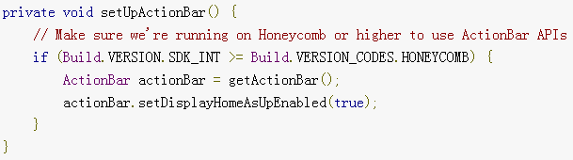
Check System Version at Runtime
Android provides a unique code for each platform version in the Build constants class.

Slide 28
Note: When parsing XML resources, Android ignores XML attributes that aren’t supported by the current device. So you can safely use XML attributes that are only supported by newer versions without worrying about older versions breaking when they encounter that code.

Slide 29
Use Platform Styles and Themes
Android provides user experience themes that give apps the look and feel of the underlying operating system.
These themes can be applied to your app within the manifest file.

Slide 30
To make your activity look like a dialog box:
To make your activity have a transparent background:
To apply your own custom theme defined in /res/values/styles.xml:

Slide 31
To apply a theme to your entire app (all activities), add the android:theme attribute to the <application> element:

